Slide 1
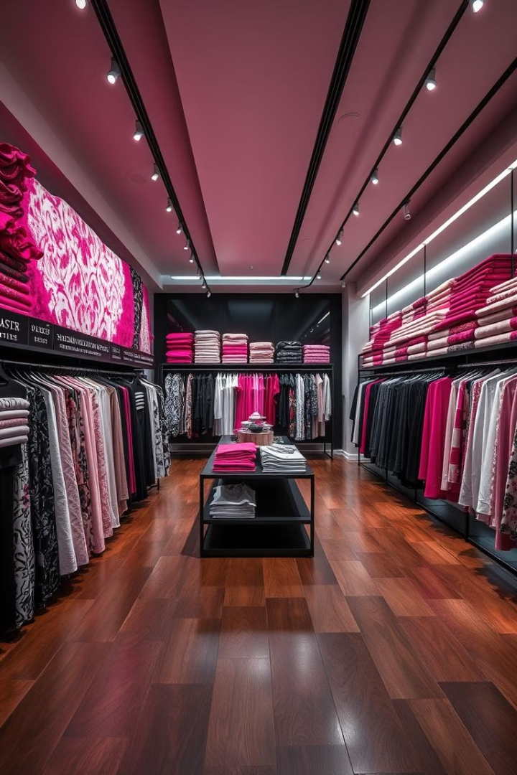
Fashion E-Commerce Platform
WP-1024
Department of Information Technology
SLIATE KEGALLE

Slide 2
GROUP MEMBERS
KEG/IT/2022/F/0062-M.A.D.A.Hemachandra(Group Leader)
KEG/IT/2022/F/0075-P.D.M.Karunarathna
KEG/IT/2022/F/0078-M.M.N.I.S.Bandara
KEG/IT/2022/F/0079-N.N.M.I.T.Gunawardana

Slide 3
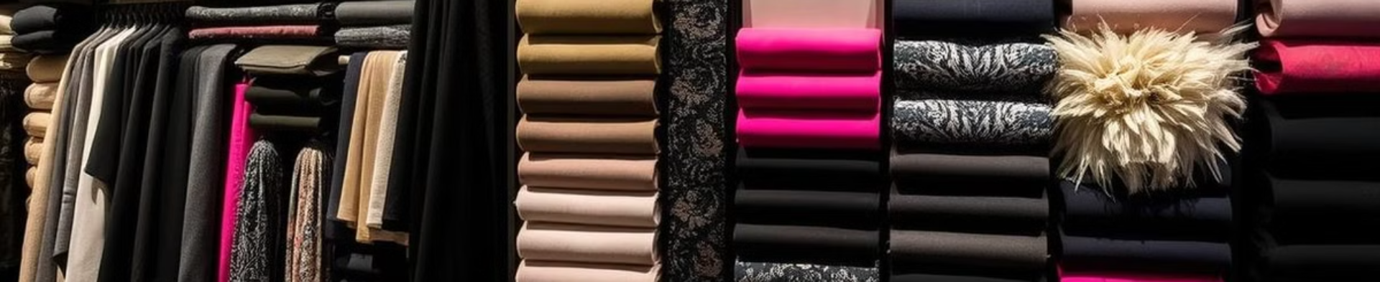
INTRODUCTION
A fashion e-commerce platform is an online store offering a wide range of clothing, accessories, and footwear for customers. It provides a user-friendly interface for browsing collections, personalized recommendations, secure payment options, and efficient delivery services. The platform connects fashion enthusiasts with the latest trends and styles.

Slide 4
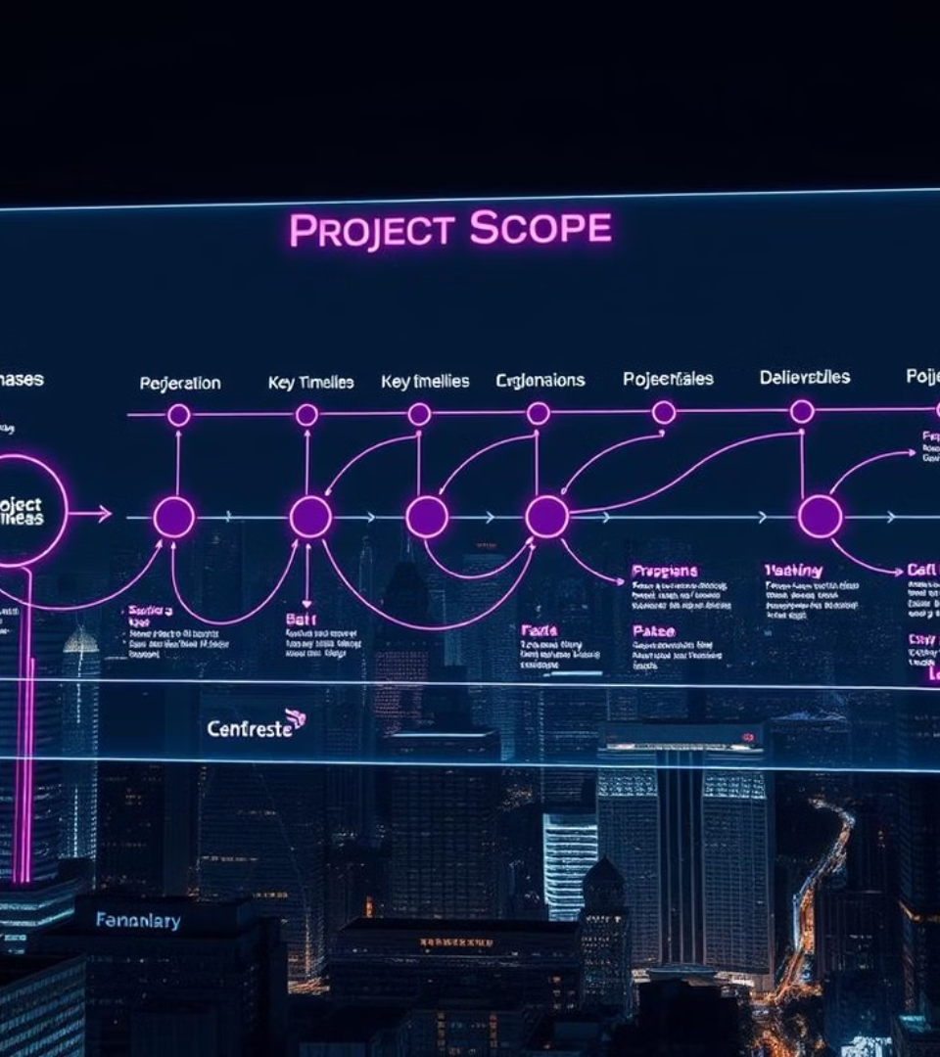
PROJECT SCOPE
Fashion E-Commerce Platform
Login and Registration
Manage Products and Display Products
User Account Management and Wishlist
Checkout

Slide 5

Login and Registration (KEG/IT/2022/F/78)
C - Add a new user to the database when they register.
R - Verify user credentials during login. All user details display in the admin dashboard.
U - Change user type and mark the account as suspended.
D - Remove a user account completely from the database.

Slide 6

User Account Management and Wishlist (KEG/IT/2022/F/62)
C - Add an item to the user’s wihshlist
R - Display all the items in the user’s wihshlist
U - User account profile update
D - Remove an item from the user’s wihshlist

Slide 7
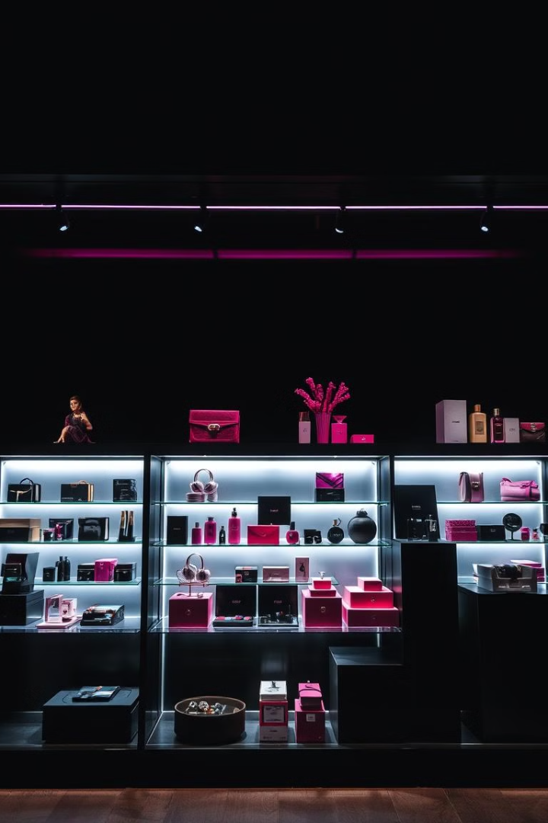
Manage Products and Display Products (KEG/IT/2022/F/79)
C - Insert new products into the database through the admin panel.
R - Display all products for the admin to manage.
U - Allow the admin to update product details.
D - Remove products that are no longer needed from the database.

Slide 8

Checkout (KEG/IT/2022/F/75)
C - Add products to the cart when the user selects them.
R - Show all items in the cart for the user to review.
U - Change the quantity of items in the cart.
D - Remove products from the cart when the user deletes them.

Slide 9
Thank You.

